Slide 1
Naïve Bayes
DSCI 5240 Data Mining and Machine Learning for Business
Russell R. Torres
Notes:
Module 7: Introduction to Classification/Naïve Bayes
Module Objectives:
Differentiate between classification and other predictive techniques
Differentiate between supervised and unsupervised learning methods
Identify the roles of training, validation, and test data sets in model development and evaluation
Identify the steps of the Naïve Bayes algorithm
Identify the requirements for Naïve Bayes models
Interpret the results of Naïve Bayes models

Slide 2
Probability is Invaluable to Data Analysts
But to us, probability is the very guide of life.
Bishop Joseph Butler
Notes:
All classification models essentially look at the data and try to extract patterns between the independent and dependent variables in the past and use these patterns to make predictions about the future. There are many types of patterns and ways in which such patterns might be extracted. In this module, we introduce Naïve Bayes, a classification approach that relies heavily on probabilities (calculated based on prior outcomes) to make predictions about the future. We begin with this algorithm because it is fairly simple and you already likely have a good working knowledge about probability.

Slide 3
Probability
Probability: a numerical measurement of the likelihood of an event occurring
Probabilities range from
0: We are certain the event will not occur
1: We are certain the event will occur
We often use probabilities to reduce uncertainty in decision making
Should I take that class?
What is the probability that I will get an A?
Should I speed while driving?
What is the probability I will get a ticket?
Should my company extend a loan to that customer?
What is the probability they will not default?

Slide 4
Probability
Probability can be applied to discrete or continuous variables
Discrete variables – Have a finite number of values
Nominal variables are discrete
Ex. Whether a customer will default on a loan or not
Continuous variables – Have an infinite number of possible values
Interval variables are continuous
Ex. Outstanding loan debt held by a customer
We will focus on discrete probabilities, but Naïve Bayes can be applied to either type of data

Slide 5
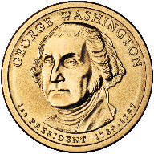
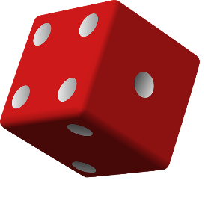
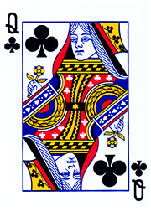
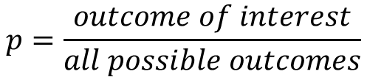



Calculating Discrete Probabilities
$$p=\frac{outcome of interest}{all possible outcomes}$$
$$p\left(heads\right)=\frac{1}{2}=0.5$$
$$p\left(1 or 6\right)=\frac{2}{6}=0.333$$
$$p\left(club\right)=\frac{13}{52}=0.25$$
Notes:
You probably recall a bit about probability from either your high school mathematics class or from a college level statistics class. However, lets quickly review as these concepts will be useful over the next couple of modules. In the case of discrete events, where the outcome is one of a set number of possible outcomes, rather than some continuous number, the probability of a given outcome of interest is equal to the number of those outcomes of interest, divided by all possible outcomes. For instance, the probability of flipping a head on a fair coin is 1 (number of heads on the coin) divided by 2 (the total number of sides on the coin), or 0.5. If we are interested in the probability of rolling a 1 or a 6 on a fair die, we divide the number of outcomes of interest, 2 (rolling a 1 or rolling a 6), by all possible outcomes, 6. Thus, we end up with a probability of one third. In a deck of playing cards, there are 52 cards divided evenly between 4 suits. If we want to calculate the probability of drawing a club, the probability would be 13 (number of clubs in the deck) divided by 52 (total number of cards in the deck), or 0.25.

Slide 6
Statistical Independence
We are often concerned with patterns of events
Sometimes the occurrence of one event influences the likelihood of another event
Statistical independence for two events is present when the outcome of the first event has no impact on the probability of the second event
Consider a customer making purchases
Chips & Salsa
Hot dogs & hot dog buns
Lettuce & Blu-ray player
This same notion of relationships among events often occurs in our datasets
$$P\left(purchase\right)=f(Income+Homeowner+…+Carowner)$$
Notes:
It is often useful for us to know what the probability of some event occurring is, given that some other event has already occurred. Consider the probability of a customer purchasing salsa. You could easily argue that the probability of purchasing salsa increases if the customer has already put a bag of chips in their cart. In this case, the two events (purchasing chips and purchasing salsa) are not statistically independent, because the probability of the second event changes based on the first. The same scenario would like take place with products like hot dogs and hot dog buns. However, what about lettuce and a blu-ray player? I find it highly unlikely that the fact that a shopper puts a head of lettuce in their cart would influence the probability that they purchase a blu-ray player. Thus, these events would likely be statistically independent.
Statistical independence is important, and we often assume that our predictors are either statistically independent or close enough to make no difference. Remember that multicollinearity can cause significant problems with some types of models… which is essentially telling you that these variables are not statistically independent.

Slide 7

Joint Probabilities
If events A and B are statistically independent, the probability of both events occurring is equal to the product of their individual probabilities
{1}
$$P\left(A∩B\right)=P\left(A\right)∗P(B)$$
?
?
Coin 1
Coin 2
$$P\left({Heads}_{Coin1}∩{Heads}_{Coin2}\right)=P\left({Heads}_{Coin1}\right)∗P({Heads}_{Coin2})$$
$$P\left({Heads}_{Coin1}∩{Heads}_{Coin2}\right)=0.5∗0.5=0.25$$
Notes:
You may have seen formula {1} in a statistics class. It says that the probability of event A occurring and event B occurring is equal to the probability of event A occurring multiplied by the probability of event B occurring. This is only true if events A and B are statistically independent. We know that the outcome of one coin flip does not influence the outcome of another coin flip, which satisfies the requirement for independence. Thus, we could calculate the probability of flipping two heads in a row as the probability of flipping one head, times the probability of flipping one head… or 0.25.

Slide 8

Conditional Probabilities
If events A and B are statistically independent, the probability of event B occurring given that event A has already occurred is equal to the probability of event B
{1}
$$P\left(B|A\right)=P\left(B\right)$$
?
Coin 1
Coin 2
$$P\left({Heads}_{Coin2}|{Heads}_{Coin1}\right)=P({Heads}_{Coin2})$$
$$P\left({Heads}_{Coin2}|{Heads}_{Coin1}\right)=0.5$$
Notes:
This can also be presented as a conditional probability. Equation {1} says that the probability of B, given that A has already occurred, is simply equal to the probability of B. That is, if we want to calculate the probability of flipping a head, given that we have already flipped a head, it is simply equal to the probability of flipping a head, or 0.5.

Slide 9

Naïve Bayes
Naïve Bayes is a type of Bayesian classifier
Bayesian classifiers use a probabilistic approach to identify to what class a given observation belongs
Examine existing evidence
For each dependent variable level (class), compute probability
Choose the class with the largest probability
$$\hat{y}=⁡\operatorname{argmax}{P\left(y|x\right)}$$
Notes:
The Naïve Bayes algorithm is a classification approach which is based on the probability of an event occurring, given that some set of events have already occurred. It works by calculating a probability for each possible outcome, and then selecting the outcome with the highest probability. The formula here expresses that by stating that the estimate for y is the maximum probability of each level of y, given that x has occurred.
Naïve Bayes is relatively simple to perform as the mathematical calculations are very simple. As such, it tends to be a very fast algorithm. Even though there are a variety of algorithms that could be argued to perform better than Naïve Bayes, they can’t match its speed. Thus, this algorithm is still widely used. One of the most common uses is in email spam filters, which predict whether a given message is spam or not spam based on the characteristics of the message.

Slide 10
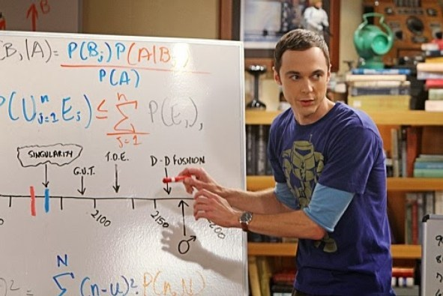
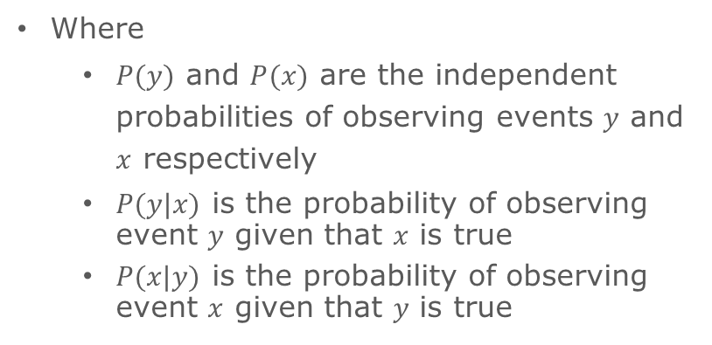
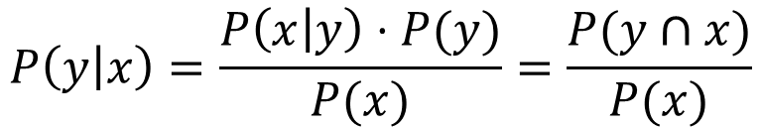
Naïve Bayes
Naïve Bayes is a probability based classification algorithm
It is based on Bayes’ theorem:
$$P\left(y | x\right)=\frac{P\left(x | y\right)⋅P(y)}{P(x)}=\frac{P(y∩x)}{P(x)}$$
Where
$P(y)$ and $P(x)$ are the independent probabilities of observing events $y$ and $x$ respectively
$P(y|x)$ is the probability of observing event $y$ given that $x$ is true
$P(x|y)$ is the probability of observing event $x$ given that $y$ is true
Notes:
Naïve Bayes is based on Bayes’ theorem. Thomas Bayes was a Presbyterian minister who lived in the 1700s. He developed an interest in probability and many believe that his theorem was developed in an attempt to prove the existence of miracles. Bayes’ theorem says that the probability of y, given that x has already occurred is equal to the probability of x, given that y occurred times the probability of y divided by the probability of x. We know that Bayes’ theorem is important, because it appears on Sheldon Cooper’s whiteboard.

Slide 11
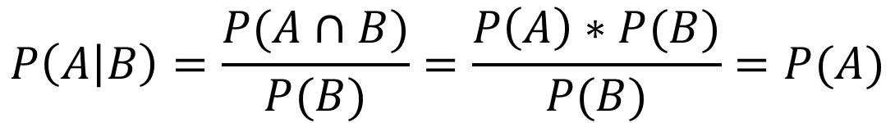

Assumptions of Naïve Bayes
Naïve Bayes is called “naïve” because it relies on the assumption that predictors are statistically independent
This is generally not the case
Predictors almost always have some degree of correlation with one another
Despite this flawed assumption, Naïve Bayes is often good enough to be useful
Remember that if A and B are independent:
{1}
$$P\left(A∩B\right)=P\left(A\right)∗P(B)$$
$$P\left(A | B\right)=\frac{P(A∩B)}{P(B)}=\frac{P\left(A\right)∗P(B)}{P(B)}=P(A)$$
{2}
This is relevant due to the way the algorithm works…
Notes:
All modeling approaches make assumptions. However, Naïve Bayes makes a very unrealistic assumption. It assumes that the predictor events (x1, x2, x3, … xn) are all statistically independent. It has to make this assumption in order to use Bayes’ theorem for prediction. This assumption is almost never held… there is always some degree of correlation between independent variables. Fortunately, even with this naïve assumption generally never being true, Naïve Bayes is generally accurate enough to be useful.

Slide 12
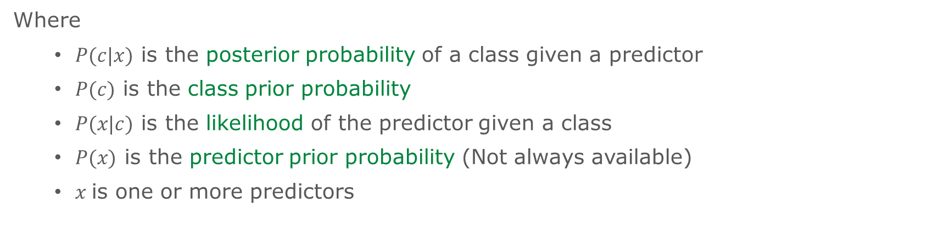
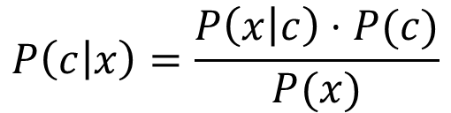
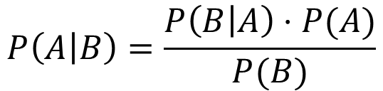
Probabilistic Modeling using Naïve Bayes
Bayes’ Theorem
Naïve Bayes
{1}
$$P\left(A | B\right)=\frac{P\left(B | A\right)⋅P(A)}{P(B)}$$
$$P\left(c | x\right)=\frac{P\left(x | c\right)⋅P(c)}{P(x)}$$
{2}
{3}
$$P\left(c | x\right)=P\left(x_{1} | c\right)⋅P\left(x_{2} | c\right)⋅…⋅P\left(x_{n} | c\right)⋅P(c)$$
Where
$P(c|x)$ is the posterior probability of a class given a predictor
$P(c)$ is the class prior probability
$P(x|c)$ is the likelihood of the predictor given a class
$P(x)$ is the predictor prior probability (Not always available)
$x$is one or more predictors
Notes:
On the left, we have Bayes’ theorem {1} and on the right we have Naïve Bayes {2}. They are essentially the same. In Naïve Bayes, we say that the probability of a class, given all of the predictors (posterior probability) is equal to the product of the likelihoods of each predictor given the class, times the probability of the class (class prior probability), divided by the probability of x (predictor prior probability – this is not always available and commonly dropped from the calculation). Because the denominator is not always available, we often present Naïve and Bayes as shown in {3}, which is actually a likelihood rather than a probability. We can then convert the likelihood into a probability. Lets look at an example…

Slide 13
An Example of Naïve Bayes Classification
Outlook | Temp | Humidity | Windy | Play?
Sunny | Hot | High | False | No
Sunny | Hot | High | True | No
Overcast | Hot | High | False | Yes
Rainy | Mild | High | False | Yes
Rainy | Cool | Normal | False | Yes
Rainy | Cool | Normal | True | No
Overcast | Cool | Normal | True | Yes
Sunny | Mild | High | False | No
Sunny | Cool | Normal | False | Yes
Rainy | Mild | Normal | False | Yes
Sunny | Mild | Normal | True | Yes
Overcast | Mild | High | True | Yes
Overcast | Hot | Normal | False | Yes
Rainy | Mild | High | True | No
Task: Develop a model to predict if John will play tennis
9 Yes
5 No
14 Total
Notes:
Consider this data. We have 4 nominal predictor variables (Outlook, Temp, Humidity, and Windy) and 1 binary dependent variable (Play). Our goal is to develop a model to predict if John will play tennis, based on his prior playing behavior.

Slide 14




Calculating Probability
Outlook | Play?
Sunny | No
Sunny | No
Overcast | Yes
Rainy | Yes
Rainy | Yes
Rainy | No
Overcast | Yes
Sunny | No
Sunny | Yes
Rainy | Yes
Sunny | Yes
Overcast | Yes
Overcast | Yes
Rainy | No
{1}
$$P\left(x | c\right)=P\left(Sunny | Yes\right)=\frac{2}{9}=0.22$$
Outlook | Yes | No
Sunny | 2/9 | 3/5 | 5/14
Overcast | 4/9 | 0/5 | 4/14
Rainy | 3/9 | 2/5 | 5/14
 | 9/14 | 5/14
$$P\left(x\right)=P\left(Sunny\right)=\frac{5}{14}=0.36$$
{3}
{2}
$$P(c)=P(Yes)=\frac{9}{14}=0.64$$
{4}
$$P\left(c | x\right)=P\left(Yes | Sunny\right)=\frac{0.22×0.64 }{0.36}=0.49$$
Notes:
Lets consider just a single variable, Outlook. Notice that outlook has 3 levels, sunny, overcast, and rainy. Because Naïve Bayes is probabilistic in nature, we must calculate probabilities of events based on the frequency with which they occur. In this case, notice that 2 out of 9 times when it was sunny, john played. Another way to say this is that the probability of it being sunny, given that John played is 2/9. This is called the likelihood of sunny given yes {1}. You can also see that John plays more often than not. 9 out of the 14 days, John played tennis. This is simply the probability of yes and is referred to here as the class prior probability {2}. We can also see that it was sunny about a third of the time, 5 out of 14 days {3}. This value is called the predictor prior probability. Using these three values, we can predict the probability of playing (Play = yes) as 0.49 {4}. It’s basically a toss up.
This example is pretty simple and you could likely approximate the probability in your head just looking at the frequency table. However, when we have multiple predictors, things become a bit more complex.

Slide 15
Example of Naïve Bayes Prediction
Outlook | Yes | No
Sunny | 2/9 | 3/5 | 5/14
Overcast | 4/9 | 0/5 | 4/14
Rainy | 3/9 | 2/5 | 5/14
 | 9/14 | 5/14
Temp | Yes | No
Hot | 2/9 | 2/5 | 4/14
Mild | 4/9 | 2/5 | 6/14
Cool | 3/9 | 1/5 | 4/14
 | 9/14 | 5/14
Humidity | Yes | No
High | 3/9 | 4/5 | 6/14
Normal | 6/9 | 1/5 | 8/14
 | 9/14 | 5/14
Windy | Yes | No
True | 3/9 | 3/5 | 6/14
False | 6/9 | 2/5 | 8/14
 | 9/14 | 5/14
Notes:
Here I have created frequency tables for each variable. We can use these to construct a Naïve Bayes model to predict John’s behavior, give these environmental conditions.

Slide 16

Likelihood of Yes
Outlook | Temp | Humidity | Windy | Play?
Sunny | Cool | High | True | ?
$${Likelihood}_{Yes}=P_{Outlook}(Sunny|Yes)⋅P_{Temp}(Cool|Yes)⋅P_{Humidity}(High|Yes)⋅P_{Windy}(True|Yes)⋅P(Yes)$$
$${Likelihood}_{Yes}=\frac{2}{9}⋅\frac{3}{9}⋅\frac{3}{9}⋅\frac{3}{9}⋅\frac{9}{14}=0.005291$$
Outlook | Yes | No
Sunny | 2/9 | 3/5 | 5/14
Overcast | 4/9 | 0/5 | 4/14
Rainy | 3/9 | 2/5 | 5/14
 | 9/14 | 5/14
Temp | Yes | No
Hot | 2/9 | 2/5 | 4/14
Mild | 4/9 | 2/5 | 6/14
Cool | 3/9 | 1/5 | 4/14
 | 9/14 | 5/14
Humidity | Yes | No
High | 3/9 | 4/5 | 7/14
Normal | 6/9 | 1/5 | 7/14
 | 9/14 | 5/14
Windy | Yes | No
True | 3/9 | 3/5 | 6/14
False | 6/9 | 2/5 | 8/14
 | 9/14 | 5/14
Notes:
Consider a day that is sunny, cool, high humidity, and windy. Would John play? To answer this question, we must first calculate the likelihood of each predictor, given John plays. The likelihood of outlook=sunny, given that John plays is 2/9. The likelihood of temp=cool, given that John plays is 3/9. The likelihood of humidity=high, given that John plays is 3/9. The likelihood of windy=true, given that John plays is 3/9. We then multiply each of these likelihoods by the class prior probability. That is, the probability that John plays, irrespective of these environmental factors. In this case, 9 out of 14 days. Multiplying these values together we end up with a likelihood value of 0.005291.

Slide 17

Likelihood of No
Outlook | Temp | Humidity | Windy | Play?
Sunny | Cool | High | True | ?
$${Likelihood}_{No}=P_{Outlook}(Sunny|No)⋅P_{Temp}(Cool|No)⋅P_{Humidity}(High|No)⋅P_{Windy}(True|No)⋅P(No)$$
$${Likelihood}_{No}=\frac{3}{5}⋅\frac{1}{5}⋅\frac{3}{5}⋅\frac{4}{5}⋅\frac{5}{14}=0.020571$$
Outlook | Yes | No
Sunny | 2/9 | 3/5 | 5/14
Overcast | 4/9 | 0/5 | 4/14
Rainy | 3/9 | 2/5 | 5/14
 | 9/14 | 5/14
Temp | Yes | No
Hot | 2/9 | 2/5 | 4/14
Mild | 4/9 | 2/5 | 6/14
Cool | 3/9 | 1/5 | 4/14
 | 9/14 | 5/14
Humidity | Yes | No
High | 3/9 | 4/5 | 7/14
Normal | 6/9 | 1/5 | 7/14
 | 9/14 | 5/14
Windy | Yes | No
True | 3/9 | 3/5 | 6/14
False | 6/9 | 2/5 | 8/14
 | 9/14 | 5/14
Notes:
We can now perform the same calculation to determine the likelihood that John will not play. Here, the likelihood of outlook=sunny, given that John does not play is 3/5. The likelihood of temp=cool, given that John does not play is 1/5. The likelihood of humidity=high, given that John does not play is 4/5. The likelihood of windy=true, given that John does not play is 3/5. We then multiply each of these likelihoods by the class prior probability for not playing. In this case, 5 out of 14 days. Multiplying these values together we end up with a likelihood value of 0.020571.

Slide 18
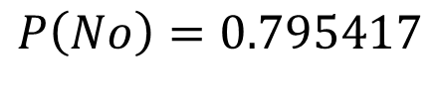

Standardization
$$P\left(Yes\right)= \frac{{Likelihood}_{Yes}}{{Likelihood}_{Yes}+{Likelihood}_{No}}=\frac{0.005291}{0.005291+0.020571}$$
$$P\left(Yes\right)=0.204583$$
$$P\left(No\right)= \frac{{Likelihood}_{No}}{{Likelihood}_{Yes}+{Likelihood}_{No}}=\frac{0.020571}{0.005291+0.020571}$$
$$P\left(No\right)=0.795417$$
Notes:
We can now convert our likelihoods into probabilities. We divide each likelihood by the sum of all of the likelihoods and we see that there is a 20% probability John will play and an 80% probability that he won’t. Thus, we would probably predict that John will not play given these environmental conditions.

Slide 19
What about Overcast Days?
Outlook | Yes | No
Sunny | 2/9 | 3/5 | 5/14
Overcast | 4/9 | 0/5 | 4/14
Rainy | 3/9 | 2/5 | 5/14
 | 9/14 | 5/14
This is a problem!
Temp | Yes | No
Hot | 2/9 | 2/5 | 4/14
Mild | 4/9 | 2/5 | 6/14
Cool | 3/9 | 1/5 | 4/14
 | 9/14 | 5/14
Humidity | Yes | No
High | 3/9 | 4/5 | 7/14
Normal | 6/9 | 1/5 | 7/14
 | 9/14 | 5/14
Windy | Yes | No
True | 3/9 | 3/5 | 6/14
False | 6/9 | 2/5 | 8/14
 | 9/14 | 5/14
Notes:
There is a circumstance under which we would have a problem. Because Naïve Bayes requires the multiplication of all relevant predictor likelihoods, we must have at least one case in which the target event occurred for each. If not, we will have zero in our long chain of values to be multiplied, resulting in a zero likelihood.

Slide 20

Likelihood of Overcast No
Outlook | Temp | Humidity | Windy | Play?
Overcast | Cool | High | True | ?
$${Likelihood}_{No}=P_{Outlook}(Overcast|No)⋅P_{Temp}(Cool|No)⋅P_{Humidity}(High|No)⋅P_{Windy}(True|No)⋅P(No)$$
$${Likelihood}_{No}=\frac{0}{5}⋅\frac{1}{5}⋅\frac{3}{5}⋅\frac{3}{5}⋅\frac{5}{14}=0.0$$
Outlook | Yes | No
Sunny | 2/9 | 3/5 | 5/14
Overcast | 4/9 | 0/5 | 4/14
Rainy | 3/9 | 2/5 | 5/14
 | 9/14 | 5/14
Temp | Yes | No
Hot | 2/9 | 2/5 | 4/14
Mild | 4/9 | 2/5 | 6/14
Cool | 3/9 | 1/5 | 4/14
 | 9/14 | 5/14
Humidity | Yes | No
High | 3/9 | 3/5 | 6/14
Normal | 6/9 | 2/5 | 8/14
 | 9/14 | 5/14
Windy | Yes | No
True | 3/9 | 3/5 | 6/14
False | 6/9 | 2/5 | 8/14
 | 9/14 | 5/14
Notes:
In this example, notice that when it was overcast, John never played (0/5). This results in the likelihood for play being zero. This is an artifact of how we are calculating the probability and is not really valid.

Slide 21
Zero Frequency Problem
The zero frequency problem occurs if a given scenario for a single predictor has not been observed, its frequency is zero
Therefore the likelihood associated with the overall scenario is estimated at zero, regardless of what other predictors suggest
The solution is to prevent zero frequencies
Variety of possible solutions exist
Most common is Laplace smoothing – add a small positive number to all frequencies (almost always 1)
Notes:
This issue is known as the zero frequency problem and the most common way to address this problem is to add one to each frequency.

Slide 22
Laplace Smoothing
Original
Step 1
Step 2
Outlook | Yes | No
Sunny | 2/9 | 3/5 | 5/14
Overcast | 4/9 | 0/5 | 4/14
Rainy | 3/9 | 2/5 | 5/14
 | 9/14 | 5/14
Outlook | Yes | No
Sunny | 2+1=3 | 3+1=4
Overcast | 4+1=5 | 0+1=1
Rainy | 3+1=4 | 2+1=3
Outlook | Yes | No
Sunny | 3 | 4 | 3+4=7
Overcast | 5 | 1 | 5+1=6
Rainy | 4 | 3 | 4+3=7
 | 3+5+4=12 | 4+1+3=8
Step 3
Smoothed
Outlook | Yes | No
Sunny | 3/12 | 4/8 | 7
Overcast | 5/12 | 1/8 | 6
Rainy | 4/12 | 3/8 | 7
 | 12 | 8 | 12+8=20
Outlook | Yes | No
Sunny | 3/12 | 4/8 | 7/20
Overcast | 5/12 | 1/8 | 6/20
Rainy | 4/12 | 3/8 | 7/20
 | 12/20 | 8/20
Notes:
By adding one to each frequency, we ensure that we will never encounter a zero and thus produce valid likelihoods. This addition does not materially impact the values of the resulting probabilities beyond this correction for zero values.

Slide 23
Zero Frequency Problem
Outlook | Yes | No
Sunny | 3/12 | 4/8 | 7/20
Overcast | 5/12 | 1/8 | 6/20
Rainy | 4/12 | 3/8 | 7/20
 | 12/20 | 8/20
Temp | Yes | No
Hot | 3/12 | 3/8 | 6/20
Mild | 5/12 | 3/8 | 8/20
Cool | 4/12 | 2/8 | 6/20
 | 12/20 | 8/20
Humidity | Yes | No
High | 4/11 | 5/7 | 9/18
Normal | 7/11 | 2/7 | 9/18
 | 11/18 | 7/18
Windy | Yes | No
True | 4/11 | 4/7 | 8/18
False | 7/11 | 3/7 | 10/18
 | 11/18 | 7/18

Slide 24
Advantages and Disadvantages
Advantages
Disadvantages
Easy to build
Easy to understand
Fast/useful for large datasets
Robust to irrelevant features
Handles both nominal and interval data
Assumes (often incorrectly) independence of features
Notes:
Naïve Bayes is a very simple algorithm. It is not supported in SAS Enterprise Miner, but a variant known as a Bayesian network is supported. However, you can see based on the math involved, this approach could be implemented fairly easily using Microsoft Excel. Its major advantages are related to simplicity and speed. Its disadvantage is that it may be less accurate than other types of models, though its results may still be accurate enough to be of value.

